Slide 1
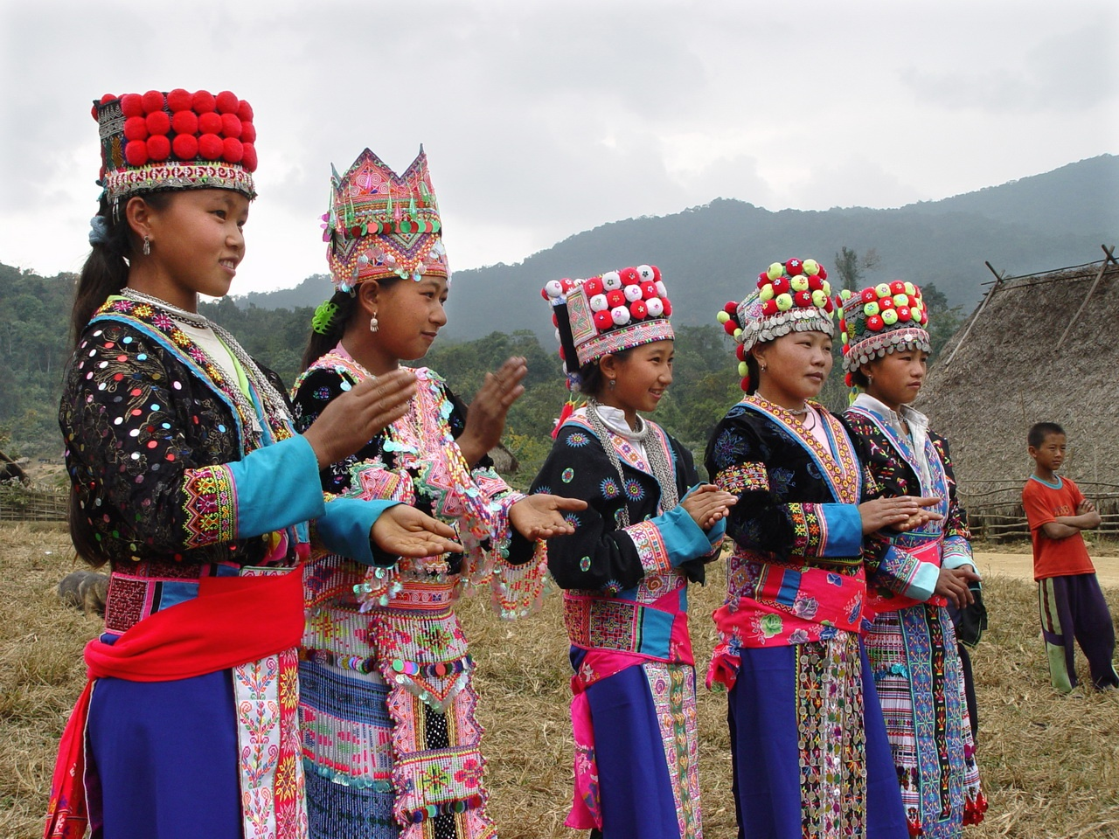
Assessment of IEC materials for Ethnic populations
CARE International in Lao PDR

Slide 2
Purpose of the study
To assess the distribution and availability of materials
To determine the usefulness of the materials
To identify opportunities for the development of new materials if needs
To assess the implementation plans

Slide 3
Study Process
Study Sites
Vientiane Capital
Phongsaly
Sample
2 interviewees from national level
2 interviewees from national radio station and 3 interviewees from provincial radio stantion
Luang Namtha
Salavan
7 interviewees from community members

Slide 4
Methodology
Questions guideline
Tape recorder
Qualitative Research

Slide 5
constraints
Phone Interview
No Screening Process

Slide 6
Data Analysis
Trends
Transcripts
Coding
Data Analysis

Slide 7
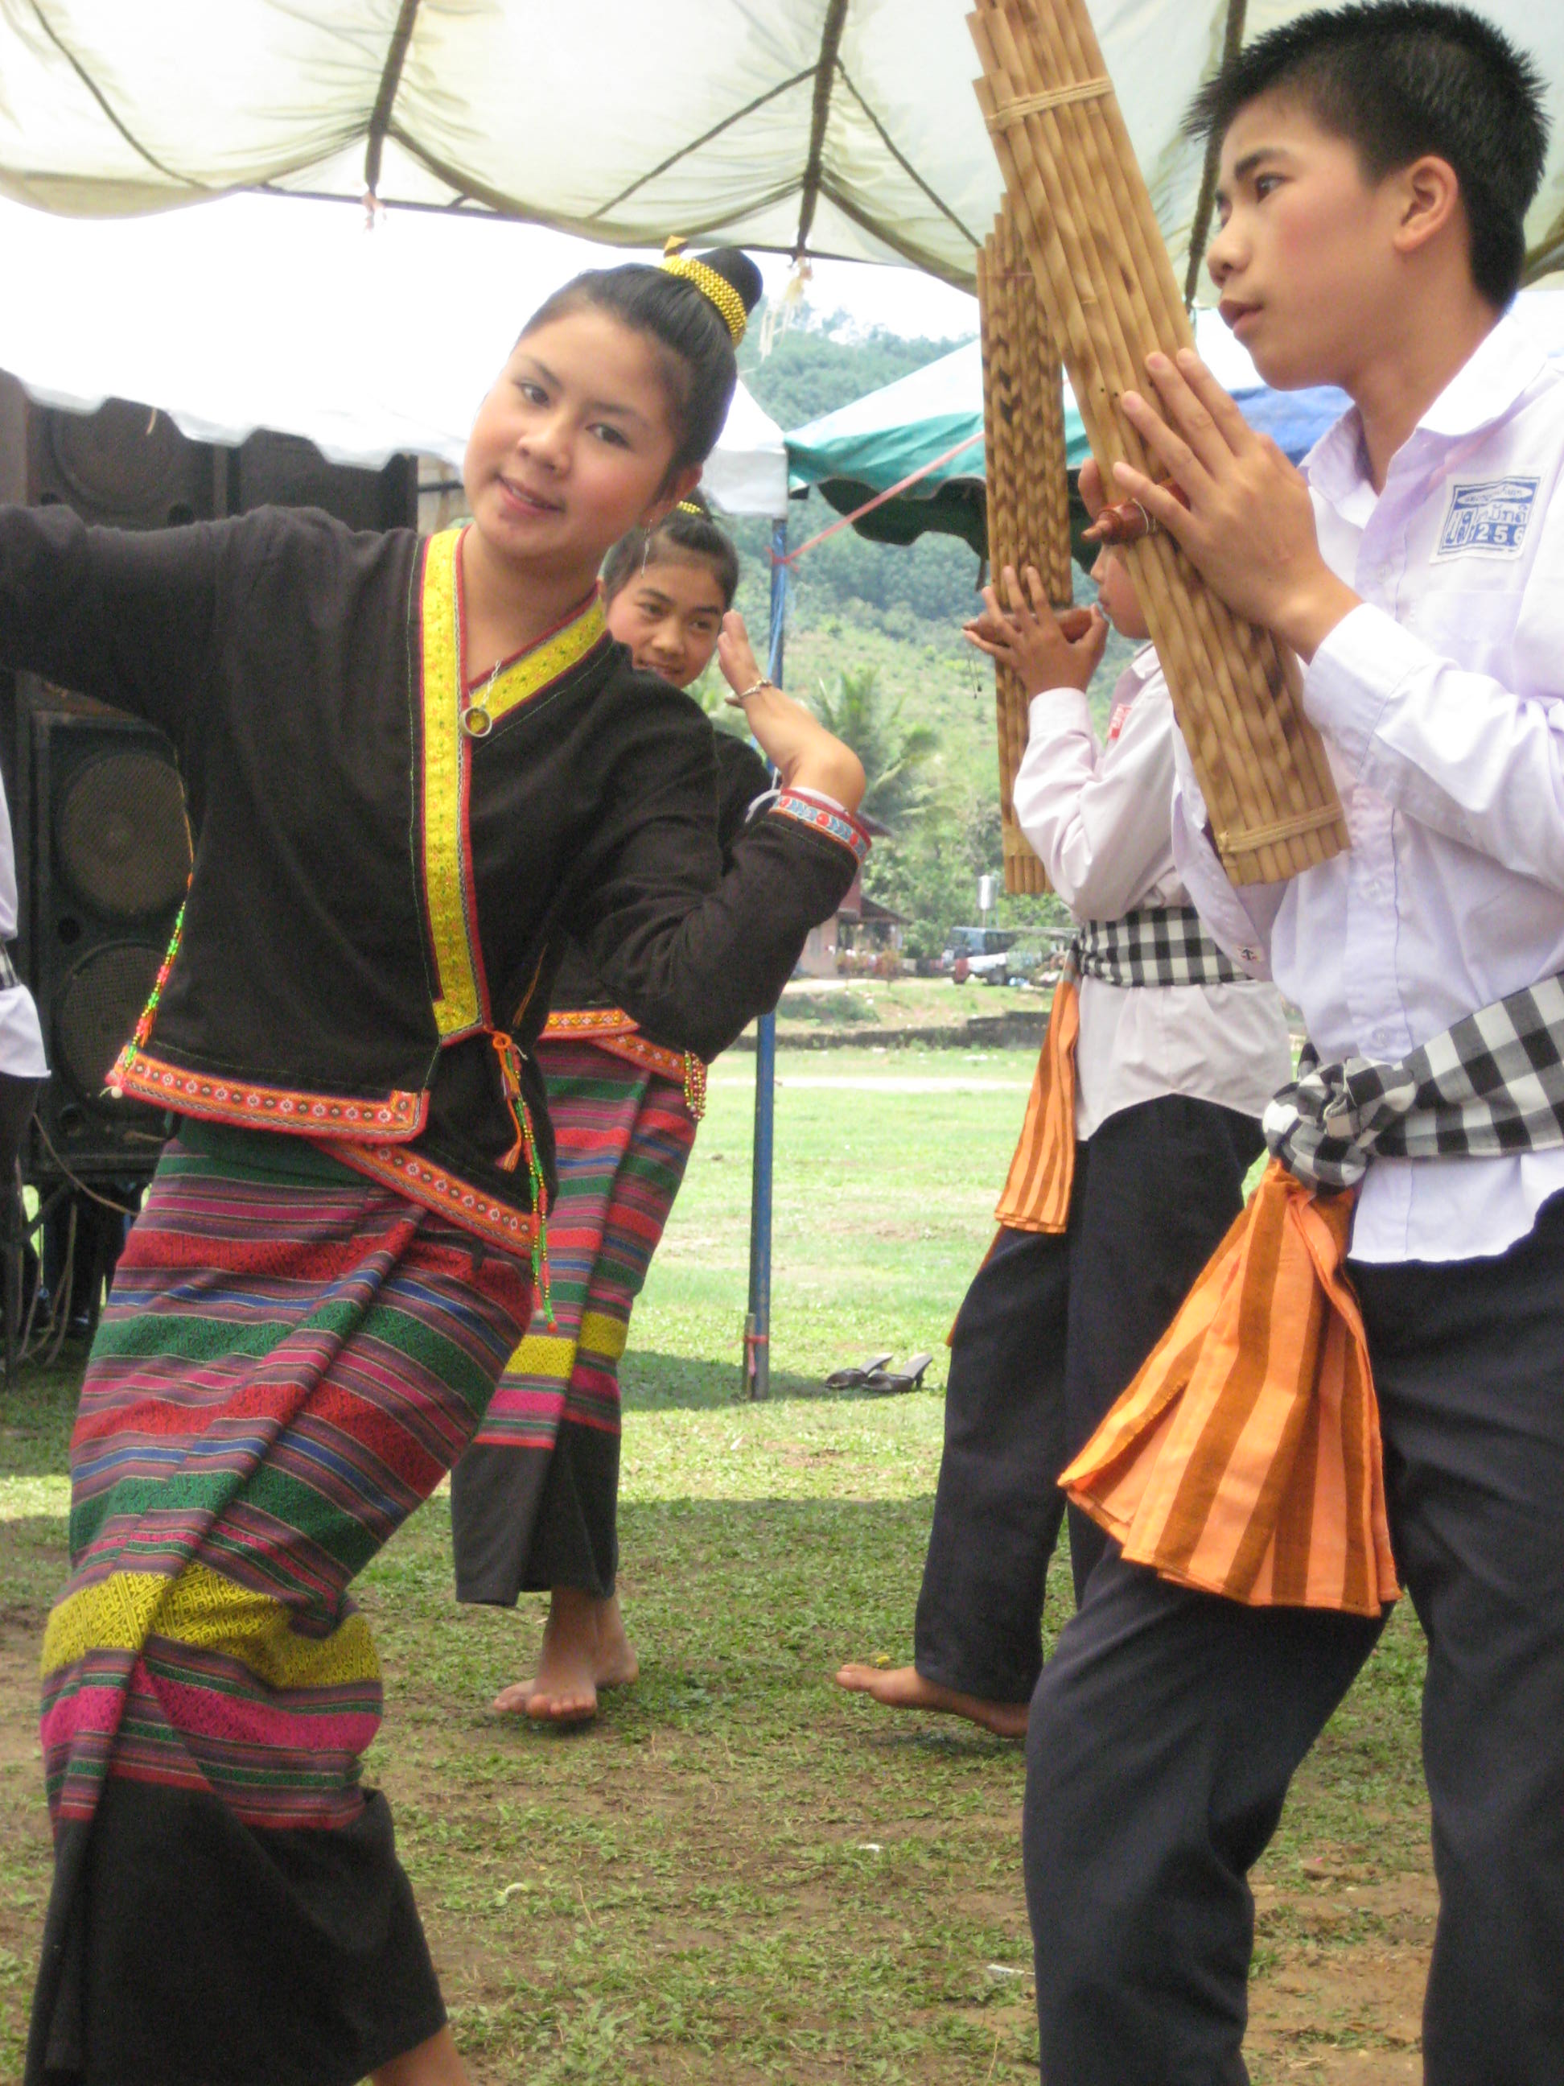
Study Results

Slide 8
Study Results
At the national level
At provincial and district level
“I have the radio spot for H1N1 only but I don’t have other materials. This is only thing I have received” Ms Sengaloune
Distribution and availability of materials

Slide 9
Continue
Important information
The spread of the disease
Discontinue
Lack of money support
No ethnic radio program
Discontinue
some ethnic group, the people can speak and understand Lao language
The length of the IEC material

Slide 10
Feedback
from community member

Slide 11
“I have heard the spot on AI long time ago (in Lavae language) but now I am not hearing it anymore.
Polert, Lavae community member, Salavan
“I have heard about it (in Hmong language) from the national radio station quite sometime ago but I never heard about these diseases from the provincial radio program.”
Bounmee, Hmong community member, Luang Namtha
“I never heard any information in Aka language from the local radio program. We received information from health staff coming to the village.”
Apouta, Aka community member, Phongsaly

Slide 12
Translation
Language

Slide 13
Usefulness of IEC materials
Knowledge about disease and prevention
“It is very useful because our people don’t understand Lao and when they heard the radio spot they learned how dangerous the disease is.” Sengaloun, Khmu radio program, Luang Namtha
Change in risk behavior
““In the past, when a flockcroup of chickens died or a bird being sick found bird falling down , people they don’t know so they eat them but now since they get information after we run the spot they know how to do when they found many bird or chicken died they report to the health office, so they have change in risk behavior” Boonnyang, Khmu National Radio Program
Members of ethnic groups have access to information
“Our people always lack information. We are very pleased when we have material in our language. The government and organizations should be involved more in helping us getting message” Mr Somchan, Khmu community member, Phongsaly

Slide 14
“During outbreak, we run spots so people get the message, also many organizations are talking about the diseases so the people are more afraid and more careful so the risk is less than during non- outbreak periods. Why: because during non-outbreak periods nobody talks about it so when a bird died or chicken dies they just eat them, it is more risk. I think they should continue with giving the message.” Mr Boonnyang, Khmu National Radio Program
Usefulness of materials
Outbreak
Non outbreak

Slide 15
“The fact that it is important both during outbreak and non-outbreak periods to get info because we don’t know when the disease will occur, so the commercial should also continue during non-outbreak periods. It is true that it is more important during outbreaks but still they need information during non-outbreak periods as well” Chaikum, provincial radio program in Phongsaly
Suggestions on the materials
Continuous use of materials
If there is updated or new information new or updated material should be developed.
Future IEC material produced in Lao should also be made available in ethnic languages
There are some ethnic groups still lacking materials in their own language
Need funding support to disseminate the material among communities in rural areas
“Actually, whenever there is material or information available in Lao language, this should also be available in ethnic languages. Sometimes, when a disease has stopped spreading already the materials in Lao language are no longer used but the materials in ethnic languages has only just become available then. Why we would need it?”
Somchan, community member in Phongsaly

Slide 16
Song, Play and short movie
Calendar
Electronic material CD, VCD
Present ethnic culture in materials
Suggestions on future development of materials
Posters & Brochures
“Songs are very popular among the audience, especially stories about the disease linked with love between men and women” Geemai, Hmong national radio program
“It would be good to produce the materials in our ethnic culture. It should be our people dressing in our clothes style and speaking our language so we feel that it is our culture and we can get along with the story and also feel deeply through that they are ours, not somebody else.” Bounnyang, Khmu National Radio Program

Slide 17
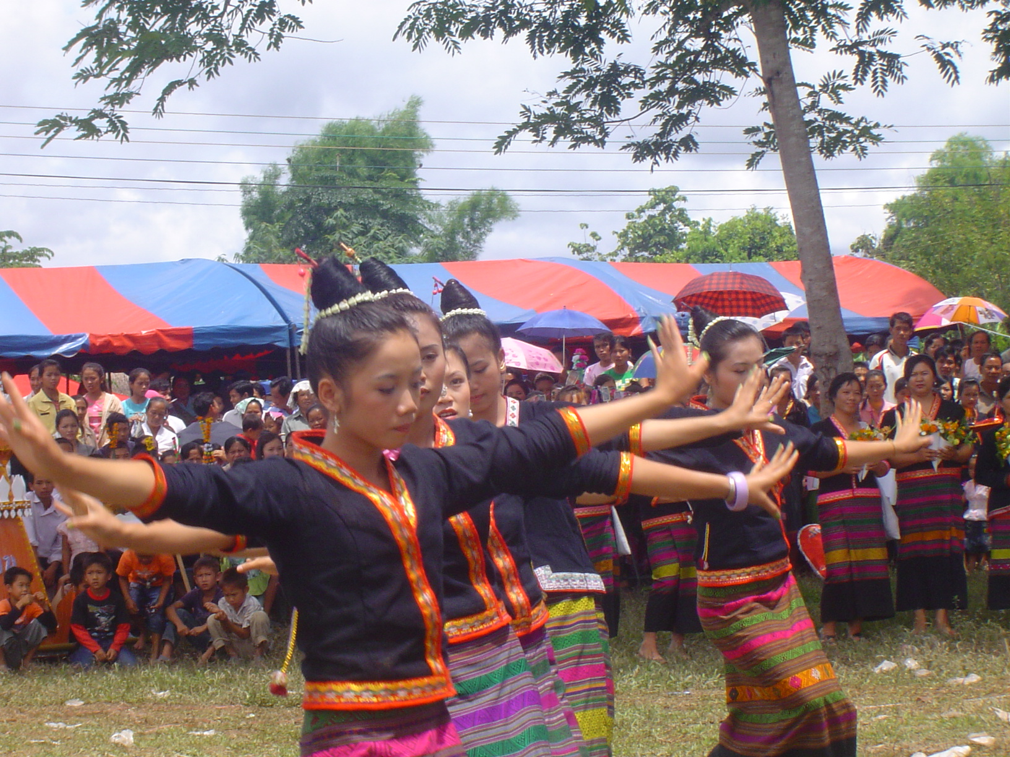
Thank you
CARE International in Lao PDR

